Slide 1

הרצאה 7
Virtual Machine I
מעבדה במחשבים מחומרה לתוכנה
קורס 10083
אריק גיספאן arikgi@post.jce.ac.il

Slide 2
Where we are at:
Human
Abstract design
Software
Thought
abstract interface
hierarchy
Chapters 9, 12
H.L. Language
Compiler
&
abstract interface
Operating Sys.
Chapters 10 - 11
Virtual
VM Translator
Machine
abstract interface
Chapters 7 - 8
Assembly
Language
Assembler
Chapter 6
abstract interface
Computer
Machine
Architecture
Language
abstract interface
Chapters 4 - 5
Gate Logic
Hardware
abstract interface
Platform
Chapters 1 - 3
Electrical
Hardware
Chips &
Engineering
Logic Gates
Physics
hierarchy

Slide 3
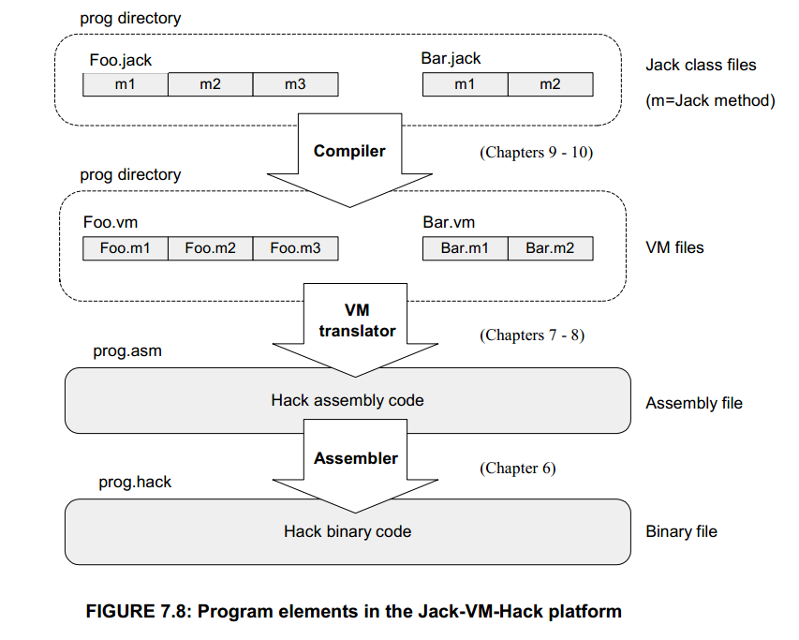
שלבי הקומפילציה
Notes:
שלושת שלבי הקומפילציה השונים:
משפה עילית .jack לשפת ביניים .vm בחלק הבא של הקורס
משפת ביניים לשפת אסמבלי - בחלק הזה של הקורס
משפת אסמבלי לשפת המכונה – מעבר ישיר

Slide 4
תרגיל 7 –Translator
VM code
ASM code
function mult 2
push constant 0
pop local 0
push argument 1
pop local 1
label loop
push local 1
push constant 0
eq
if-goto end
push local 0
push argument 0
add
pop local 0
push local 1
push constant 1
sub
pop local 1
goto loop
label end
push local 0
return
...
@a
M=D
@b
M=0
(LOOP)
@a
D=M
@b
D=D-A
@END
D;JGT
@j
D=M
@temp
M=D+M
@j
M=M+1
@LOOP
0;JMP
(END)
@END
0;JMP
...
Notes:
בתרגיל 7 תבנו translator
.vm -> .asm
בשיעור נקבל את הכלים המתאימים למשימה

Slide 5
Compilation models
Two-tier compilation:
First compilation stage depends only on the details of the source language
Second compilation stage depends only on the details of the target platform.
Notes:
ברור שהמעבר הזה תלוי ב 2 דברים – שפת הקוד, והפלטפורמה.
הפיצול ל 2 שלבים נותן לנו מסגרת אחידה לכל השפות והמחשבים

Slide 6
The big picture
The intermediate code:
The interface between the 2 compilation stages
Must be sufficiently general to support many <high-level language, machine language> pairs
Can be modeled as the language of an abstract virtual machine (VM)
Can be implemented in many different ways.
Notes:
קוד הביניים – הממשק בין 2 שלבי הקומפילציה. צריך להיות מספיק כללי ע"מ לתמוך בכל שפת קוד ומחשב.
ניתן למידול ע"י מחשב וירטואלי – נניח שיש מחשב כמו מחשב ההאק שלנו שלא קיים במציאות, אבל ניתן לאמולציה מכל מחשב, אז מספיק לנו לעשות מעבר מקוד רגיל לקוד של המחשב הוירטואלי
ניתן למימוש בהרבה דרכים

Slide 7
The big picture
. . .
. . .
Jack
Some
Some Other
language
language
language
Jack
Chapters 9-13
Some
Some Other
compiler
compiler
compiler
VM language
VM
VM imp.
implementation
VM imp.
VM
over the Hack
Chapters 7-8
over CISC
over RISC
emulator
platform
platforms
platforms
CISC
RISC
. . .
written in
Hack
machine
machine
a high-level
machine
language
language
language
language
. . .
. . .
Chapters 1-6
CISC
RISC
other digital platforms, each equipped
Any
Hack
machine
machine
with its VM implementation
computer
computer
Notes:
קוד הביניים שלנו יהיה קוד VM = VIRTUAL MAHINE ניתן לאמולציה ע"י מחשב רגיל – כמו האמולטור שיש לנו, או מימוש ע"ג מחשב ההאק. מחשב ההאק שלנו הוא בעצמו מחשב וירטואלי

Slide 8
היררכית תוכנית VM
VM Program : collection of one or more .vm files
Class: single .vm file with one or more functions
Foo.vm
Foo.func1
Foo.func2
Foo.func3
Bar.vm
Bar.func1
Bar.func2
Notes:
כל תוכנית VM מורכבת מקבצי VM שונים
כל אחד מהם מכיל אחת או יותר פונקציות – זה מקביל למחלקה בג'אוה
פונקציות אתם כבר מכירים...

Slide 9
The VM language
Important:
From here till the end of this and the next lecture we describe the VM model used in the Hack-Jack platform
Other VM models (like JVM/JRE and IL/CLR) are similar in spirit and different in scope and details.
Our VM features a single 16-bit data type that can be used as:
Integer
Boolean
Pointer.
Notes:
שימו לב ששפת ה VM משמשת לנו למעבר בין שפת JACK לשפת המכונה HACK
מודלים אחרים של VM דומים אבל בנויים מעט אחרת. העקרונות שנלמד פה מספיקים כדי להבין על מודלים אחרים של VM. יש לנו 3 סוגי נתונים פה,
Int, bool, pointer

Slide 10
Lecture plan
Goal: Specify and implement a VM model and language
Arithmetic / Boolean commands
add
sub
neg
eq
gt
lt
and
or
not
Memory access commands
pop x (variable)
push y (variable or constant)
Program flow commands
label (declaration)
goto (label)
if-goto (label)
Function calling commands
function (declaration)
call (a function)
return (from a function)
This lecture
Next lecture
Method: (a) specify the abstraction (model’s constructs and commands) (b) propose how to implement it over the Hack platform.
Notes:
אנחנו נלמד את מודל ושפת VM.
נלמד את האבסטרקציה – מסנה השפה, ונציע איך לממש אותה על מחשב ההאק
יש 4 סוגי פקודות ב VM
פעולות אריתמטיות \ בוליאניות
פעולות בזיכרון
Program Flow
פונקציות

Slide 11
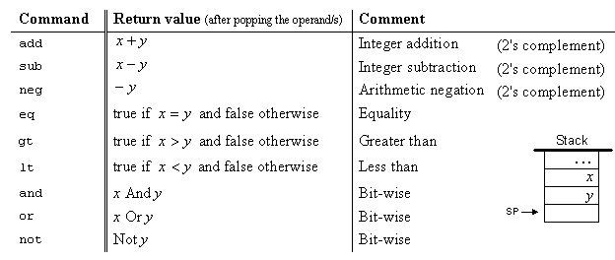

פעולות אריתמטיות \ בוליאניות
Notes:
יש 9 פעולות – 2 אונאריות ו7 בינאריות

Slide 12
פעולות אריתמטיות \ בוליאניות
Unary operations (neg, not) don’t change stack size.
Binary operations (all but neg,not) change stack size in -1.
Boolean operations (eq,gt,lt) result in true(-1) or false (0) values in the stack.
Boolean operations require label usage.
Notes:
יש 9 פעולות – 2 אונאריות ו7 בינאריות

Slide 13
Stack arithmetic
Typical operation:
Pops topmost values x,y from the stack
Computes the value of some function f(x,y)
Pushes the result onto the stack
(Unary operations are similar, using x and f(x) instead)
Impact: the operands are replaced with the operation’s result
In general: all arithmetic and Boolean operations are implemented similarly.
Notes:
המחסנית -

Slide 14
Memory access (first approximation)

Slide 15
Memory access (first approximation)
Classical data structure
Elegant and powerful
Many implementation options.

Slide 16
Evaluation of arithmetic expressions

Slide 17
Evaluation of Boolean expressions

Slide 18
Memory access (motivation)
Modern programming languages normally feature the following variable kinds:
Class level
Static variables
Private variables (AKA “object variabls” / “fields” / “properties”)
Method level:
Local variables
Argument variables
A VM abstraction must support (at least) all these variable kinds.
The memory of our VM model consists of 8 memory segments: static, argument, local, this, that, constant, pointer, and temp.

Slide 19
Memory access commands
Command format:
pop segment i
push segment i
(Rather than pop x and push y, as was shown in previous slides, which was a conceptual simplification)
Where i is a non-negative integer and segment is one of the following:
static: holds values of global variables, shared by all functions in the same class
argument: holds values of the argument variables of the current function
local: holds values of the local variables of the current function
this: holds values of the private (“object”) variables of the current object
that: holds array values
constant: holds all the constants in the range 0…32767 (pseudo memory segment)
pointer: used to align this and that with different areas in the heap
temp: fixed 8-entry segment that holds temporary variables for general use; Shared by all VM functions in the program.
Notes:
פקודה של המחסנית מורכבת למעשה מ 3 חלקים: push/pop ואז סגמנט ואז אינדקס

Slide 20
פעולות זיכרון push/pop
Push command changes stack size in +1, while pop is -1.
Push X = stack <- X(memory)
Pop X = stack -> X(memory)
local i = RAM[ RAM[LCL] +i ]
argument i = RAM[ RAM[ARG] +i]
this i = RAM[ RAM[THIS] +i]
that i = RAM[ RAM[THAT] +i]
temp i = RAM[5 +i]
pointer i = RAM[3 +i]
constant i = i
static i (assume file name is File.asm) = @File.i.
Static memory allocation in the VMEmulator, is different from what we have learned
Notes:
יש 9 פעולות – 2 אונאריות ו7 בינאריות

Slide 21
VM implementation on the Hack platform
The challenge: (i) map the VM constructs on the host RAM, and (ii) given this mapping, figure out how to implement each VM command using assembly commands that operate on the RAM
local,argument,this,that: mapped on the heap. The base addresses of these segments are kept in LCL,ARG,THIS,THAT. Access to the i-th entry of a segment is implemented by accessing the segment’s (base + i) word in the RAM
static: static variable number j in a VM file f is implemented by the assembly language symbol f.j (and recall that the assembler maps such symbols to the RAM starting from address 16)
constant: truly a virtual segment. Access to constant i is implemented by supplying the constant i
pointer,temp: see the book
Exercise: given the above game rules, write the Hack commands that implement, say, push constant 5 and pop local 2.
Host RAM
Notes:
איך זה עובד באמת?

Slide 22
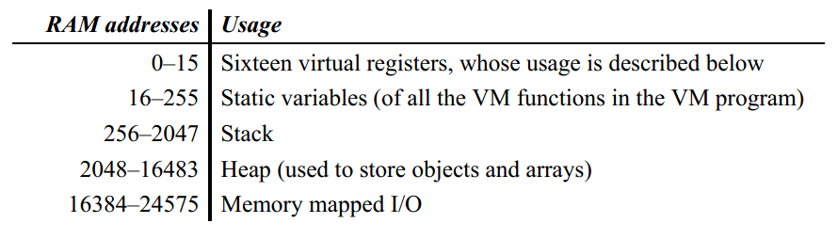
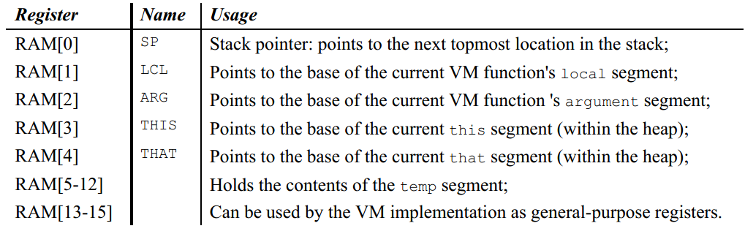

Slide 23
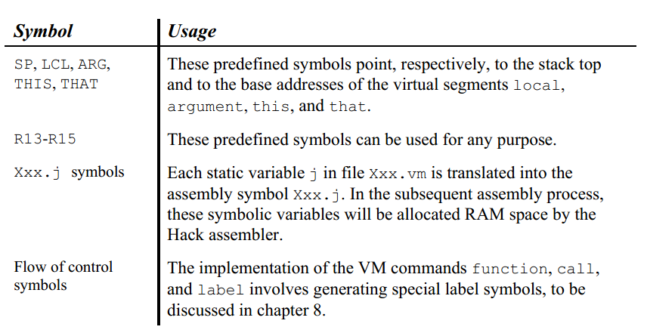

Slide 24
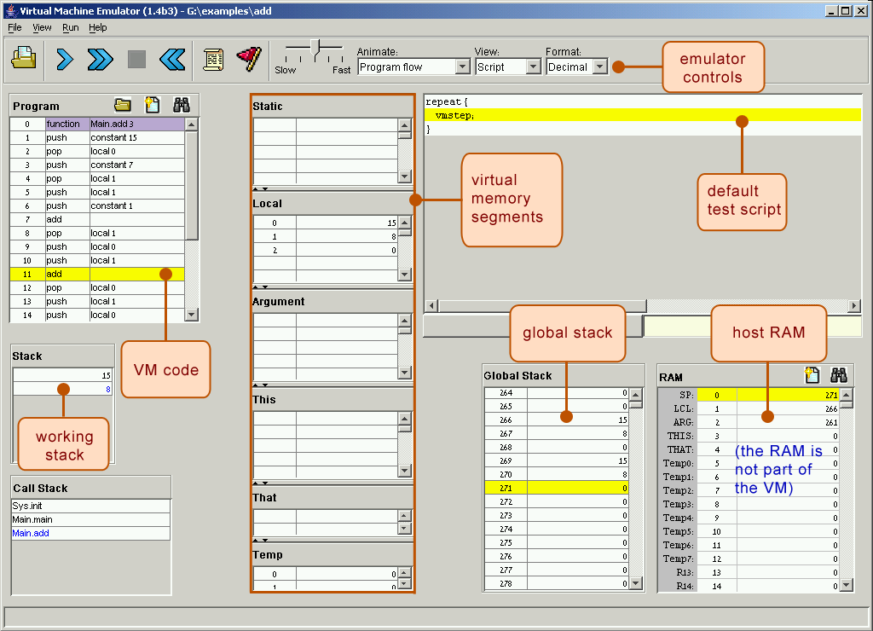
Our VM emulator (part of the course software suite)

Slide 25
Parser module (proposed design)
Parser: Handles the parsing of a single .vm file, and encapsulates access to the input code. It reads VM commands, parses them, and provides convenient access to their components. In addition, it removes all white space and comments.
Routine | Arguments | Returns | Function
Constructor | Input file / stream | -- | Opens the input file/stream and gets ready to parse it.
hasMoreCommands | -- | boolean | Are there more commands in the input?
advance | -- | -- | Reads the next command from the input and makes it the current command. Should be called only if hasMoreCommands() is true. Initially there is no current command.
commandType | -- | C_ARITHMETIC, C_PUSH, C_POP, C_LABEL, C_GOTO, C_IF, C_FUNCTION, C_RETURN, C_CALL | Returns the type of the current VM command. C_ARITHMETIC is returned for all the arithmetic commands.
arg1 | -- | string | Returns the first argument of the current command. In the case of C_ARITHMETIC, the command itself (add, sub, etc.) is returned. Should not be called if the current command is C_RETURN.
arg2 | -- | int | Returns the second argument of the current command. Should be called only if the current command is C_PUSH, C_POP, C_FUNCTION, or C_CALL.

Slide 26
CodeWriter module (proposed design)
CodeWriter: Translates VM commands into Hack assembly code.
Routine | Arguments | Returns | Function
Constructor | Output file / stream | -- | Opens the output file/stream and gets ready to write into it.
setFileName | fileName (string) | -- | Informs the code writer that the translation of a new VM file is started.
writeArithmetic | command (string) | -- | Writes the assembly code that is the translation of the given arithmetic command.
WritePushPop | Command (C_PUSH or C_POP), segment (string), index (int) | -- | Writes the assembly code that is the translation of the given command, where command is either C_PUSH or C_POP.
Close | -- | -- | Closes the output file.
Comment: More routines will be added to this module in chapter 8.

